Slide 1
< Parallel Game Programming>
< Jordi Bach balcells>

Slide 2



Parallel Programming
What?
Why?
Promising performance
How?
Multithreading
Parallel hardware
Not used until now
GPU
SIMD
(GP)GPU
Platform layer

Slide 3
Multithreading
Definition
Use multiple CPU logical cores
Scheduler
Preemtive multitasking
Synchronization
Why needed?
Problems
Overhead / Context switch
Round Robin
Implementation
Blocked threads / Too much threads

Slide 4
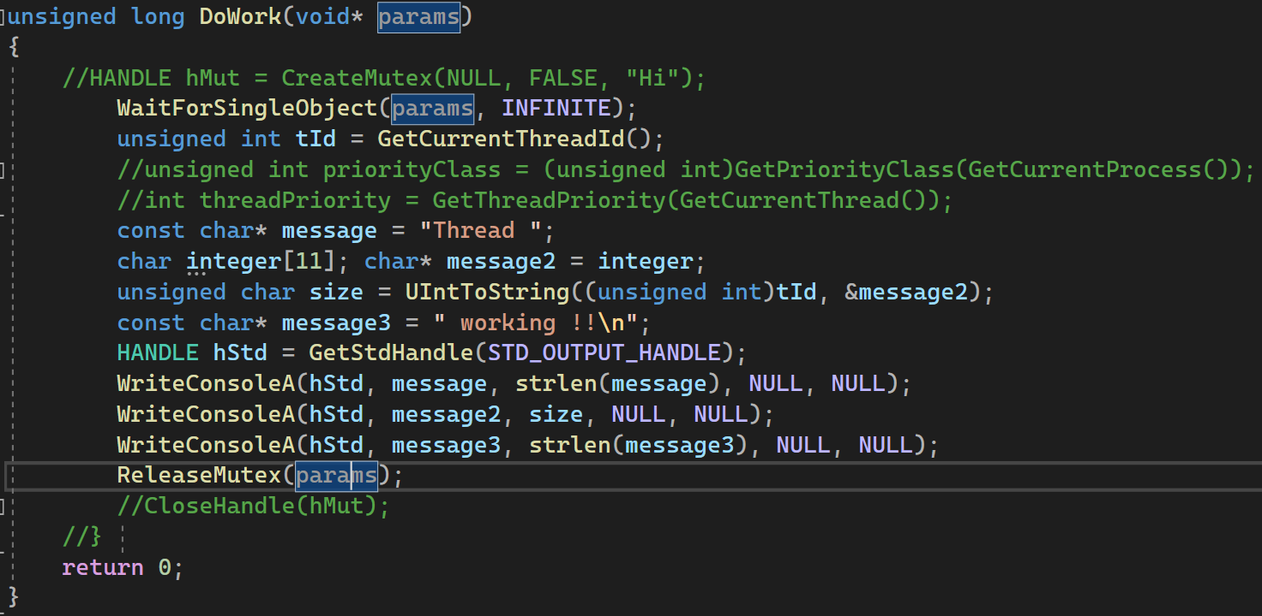
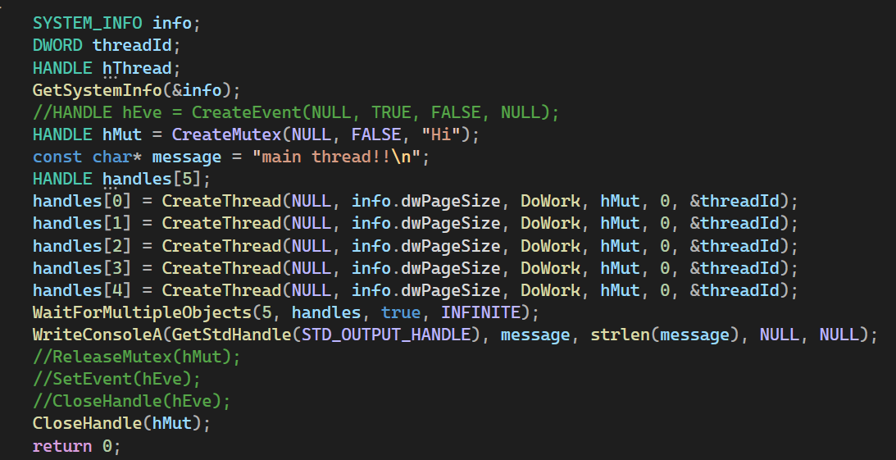
Multithreading

Slide 5
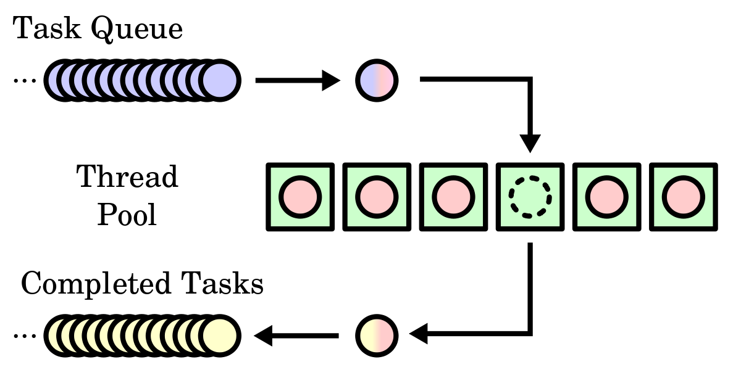
Multithreading

Slide 6
SIMD
Definition
Single instruction multiple data
Implementation
Compiler flag
Problem
Portability
Solutions
SSE4
Intrinsics / Assembly language
Runtime function dispatching

Slide 7
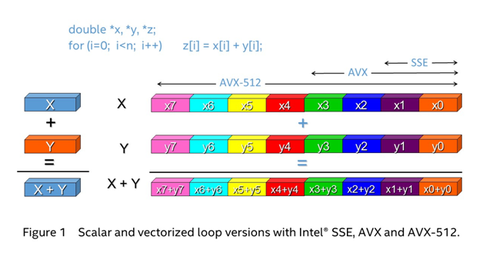
SIMD

Slide 8
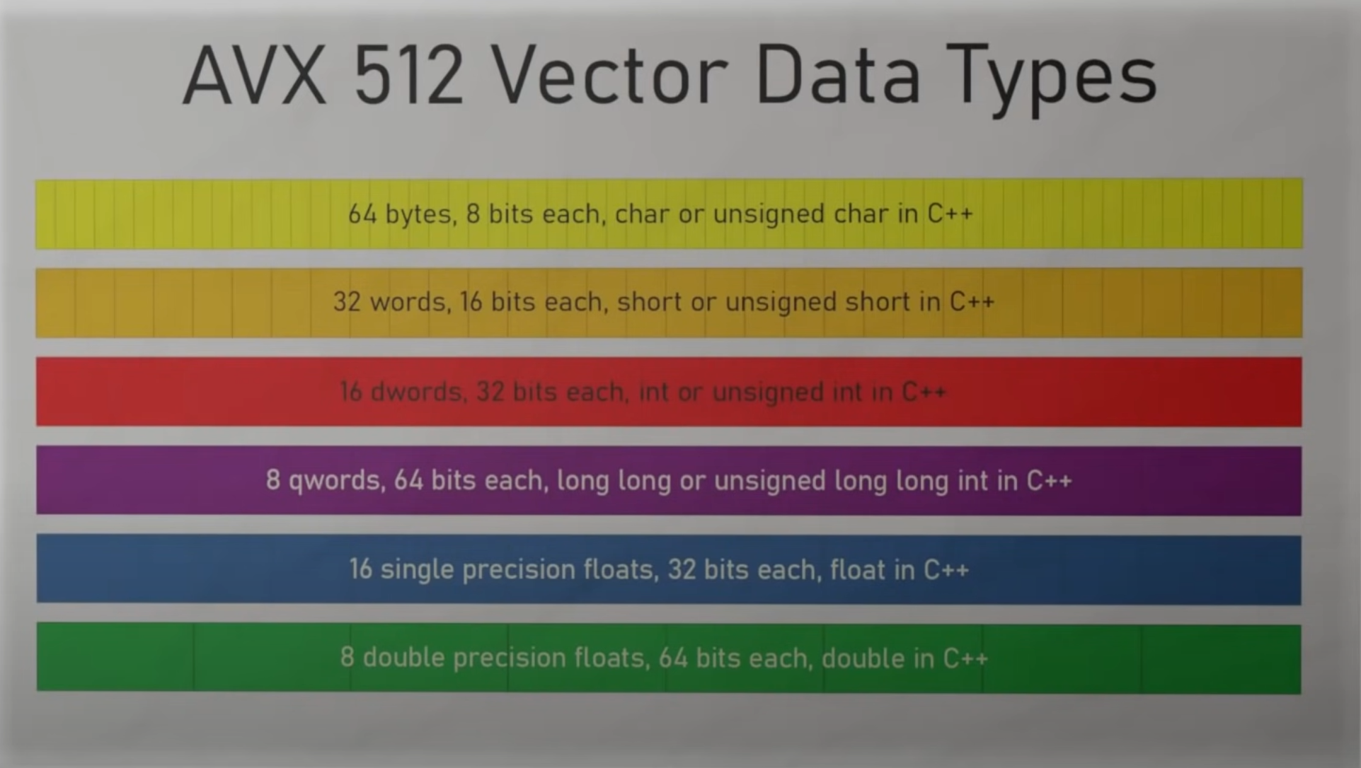
SIMD

Slide 9
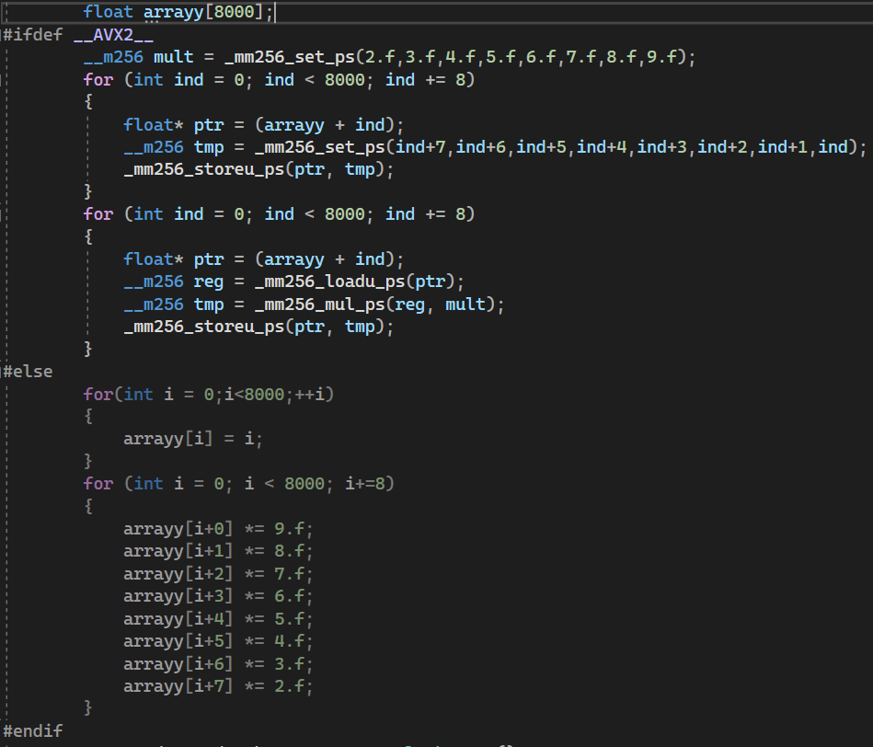
SIMD
https://www.intel.com/content/www/us/en/docs/intrinsics-guide/index.html#

Slide 10
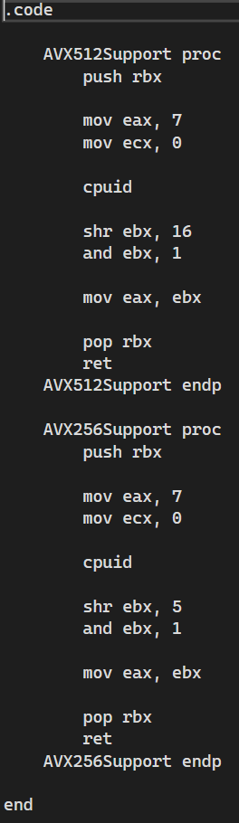
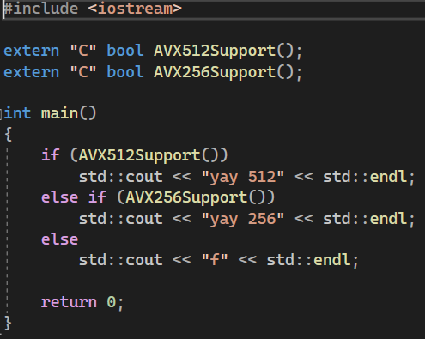
SIMD

Slide 11
GPU
Definition
Coprocessor
GPU vs. CPU hardware
Serial vs Parallel / Latency vs Throughput
GPU software (CUDA)
Grayscale Image
Optimization
Memory layout and access patterns
Cores / Frequency / Memory bandwidth
Occupancy & Concurrency
SIMT / Shared Memory

Slide 12
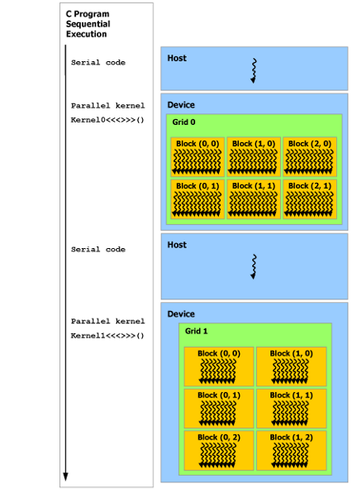
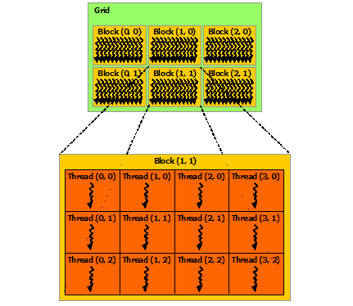
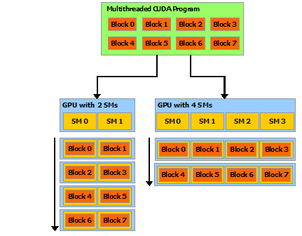
GPU

Slide 13
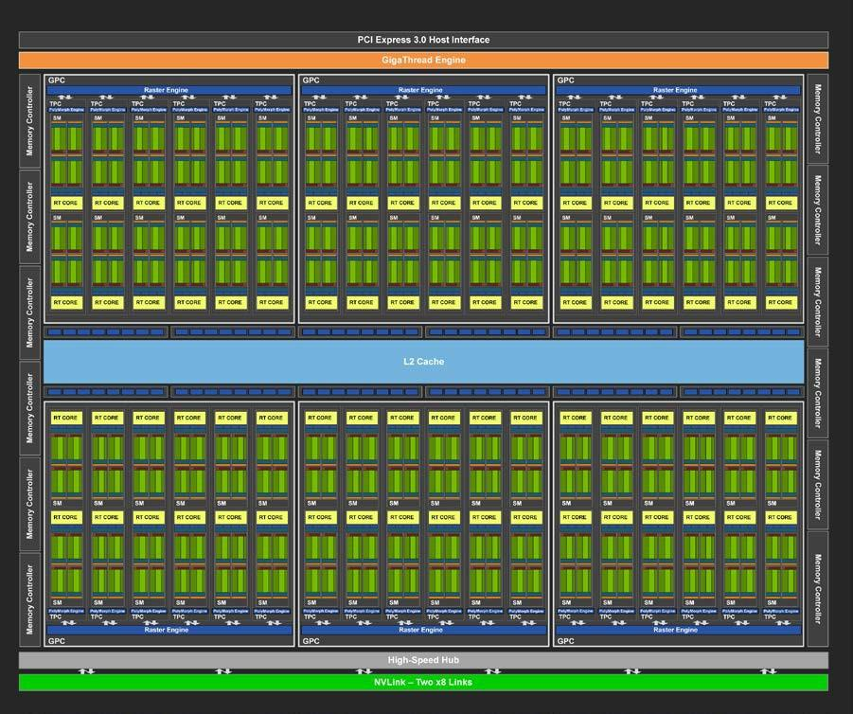
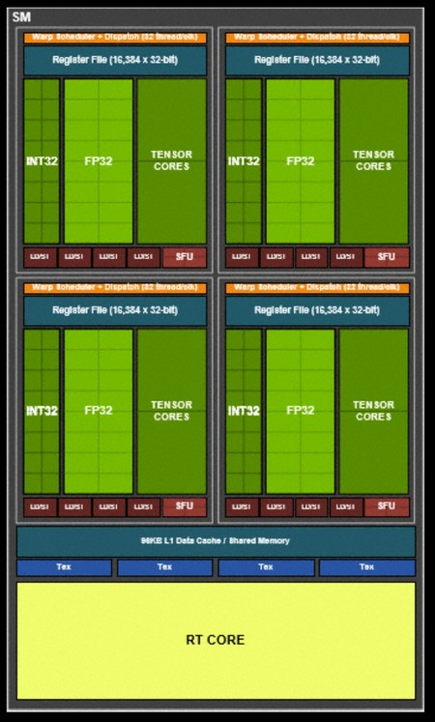
GPU
1 SM Compute capability 7.5 (Turing):
64 FP32 cores
32 FP64 cores
64 INT32 cores
8 Tensor cores
16 SFU
4 warp schedulers
96 KB L1 cache

Slide 14
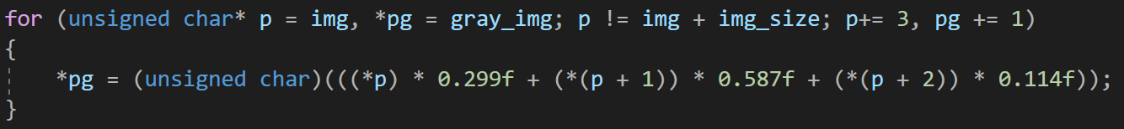
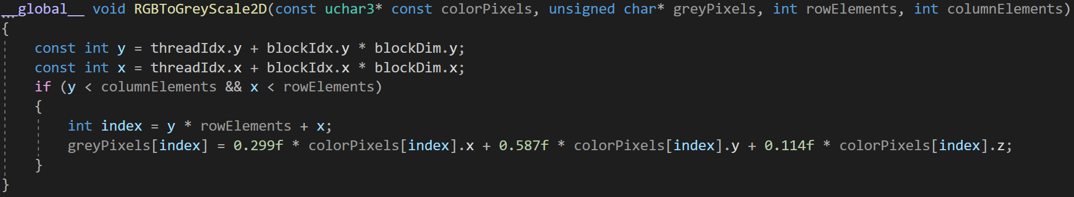
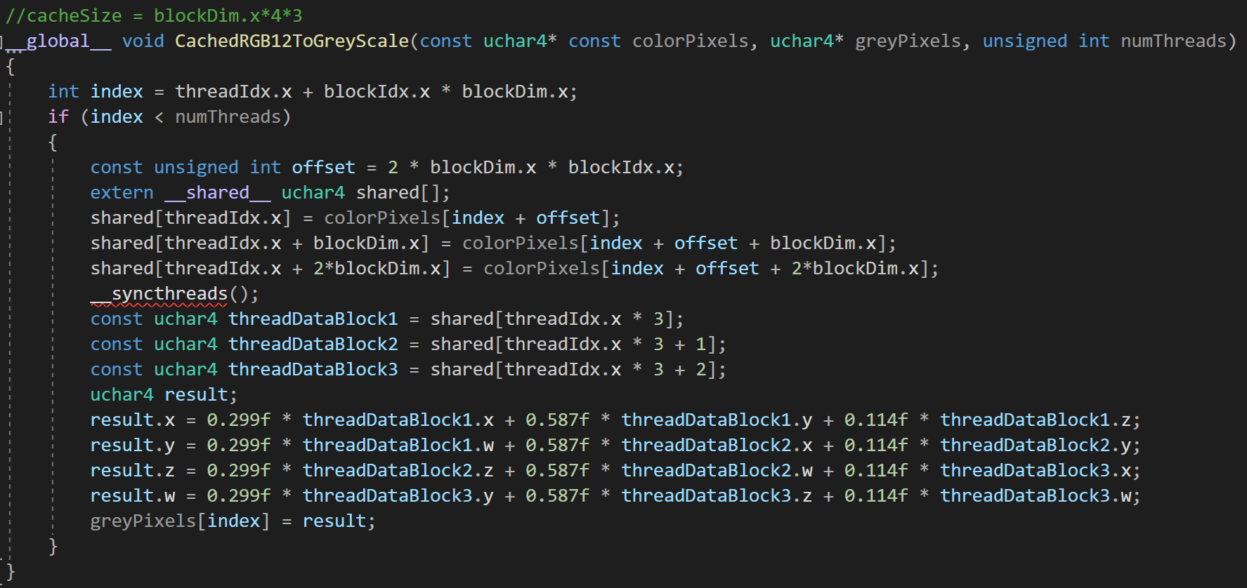
GPU
CPU loop
GPU kernel
GPU kernel
40% faster

Slide 15
GPU
4k
CPU: 13 ms
GPU: 0.3 ms
8k
CPU: 53 ms
GPU: 0.62 ms

Slide 16
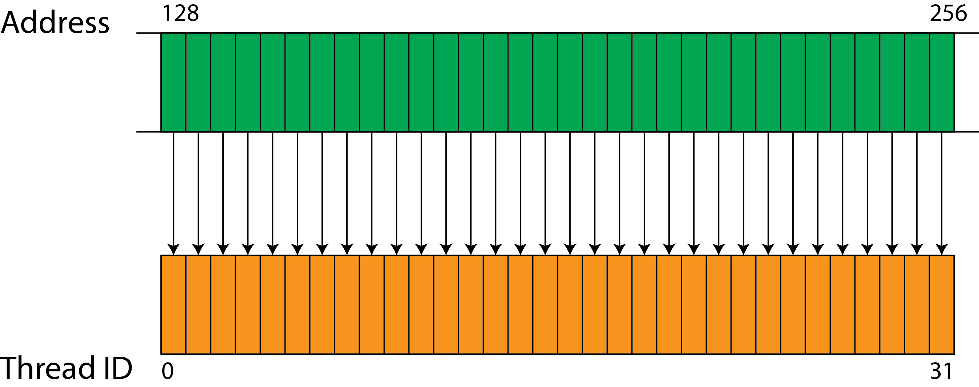
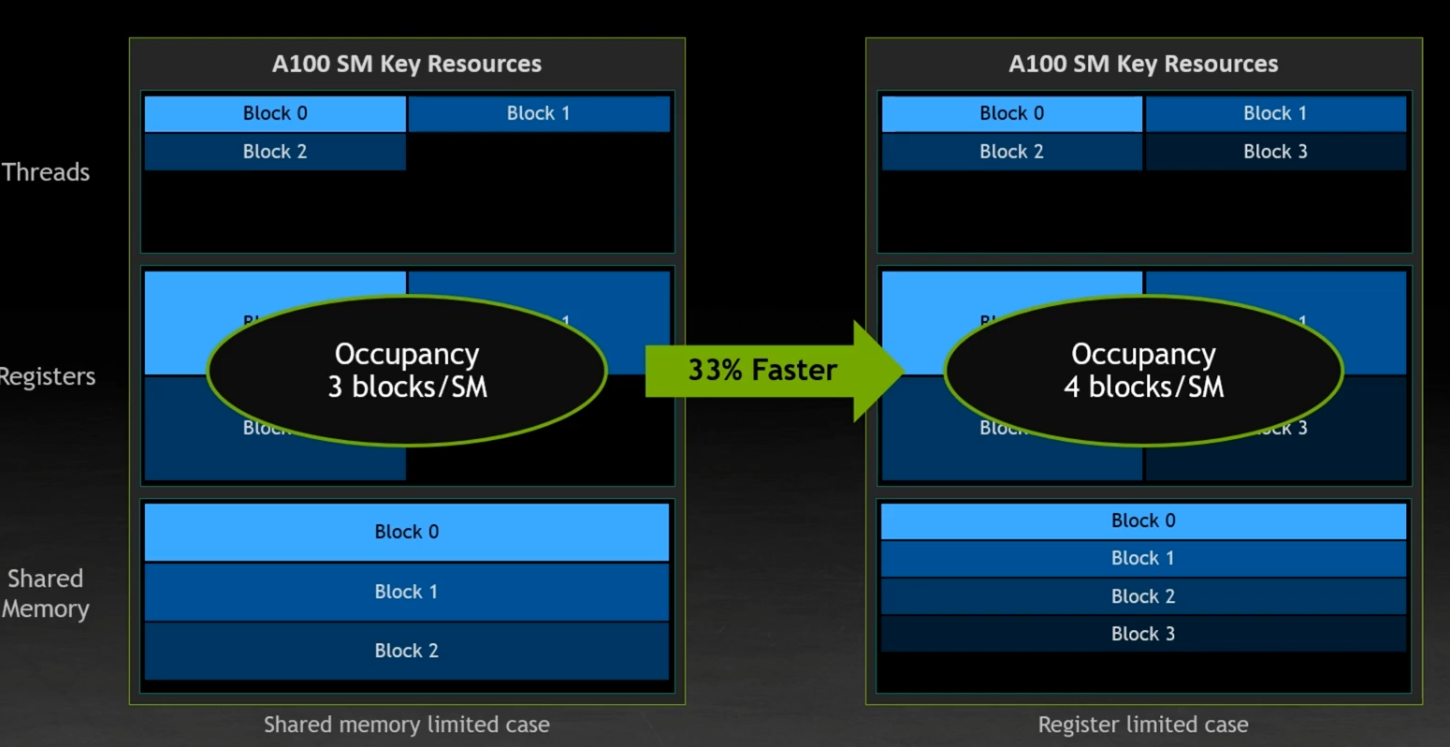
GPU

Slide 17
DirectX12
DirectX12
CUDA not portable
Low-Level renderer
Memory residency / Resource binding
GPU-CPU synchronization
Application responsability
Compute pipeline (GPGPU)
Mipmapping
Shaders / Pipelines
GPU work submission

Slide 18
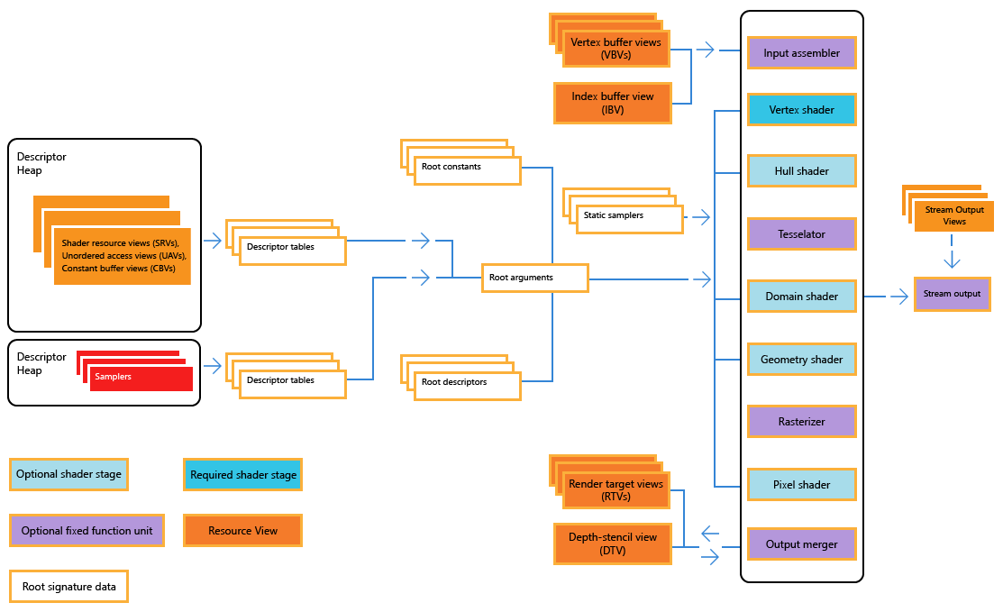
DirectX12

Slide 19
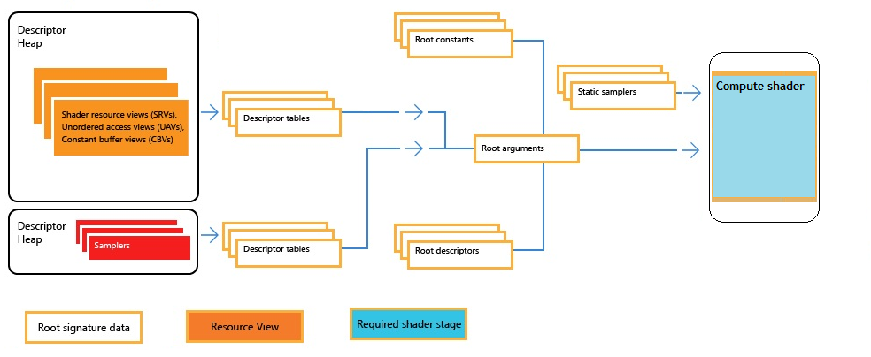
DirectX12

Slide 20
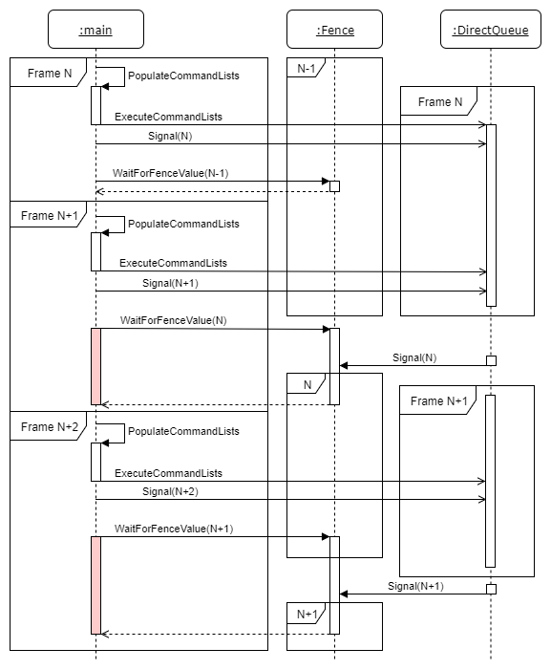
DirectX12

Slide 21
DirectX12

Slide 22
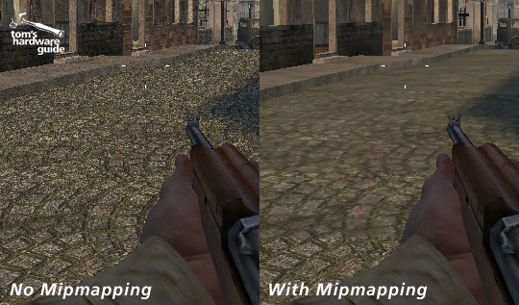
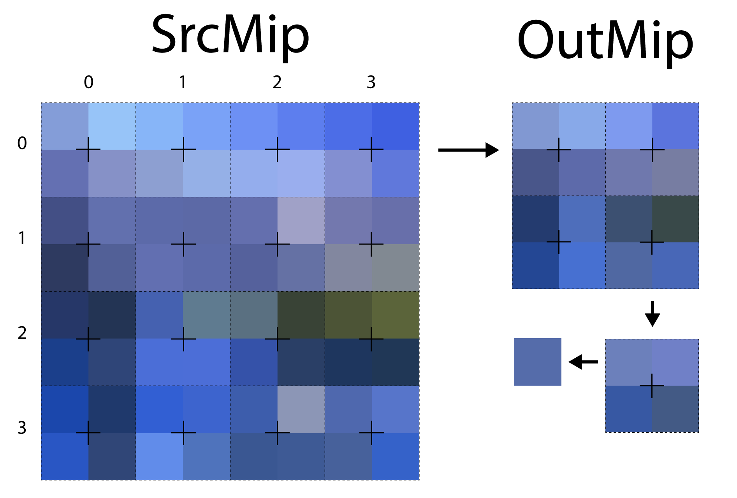
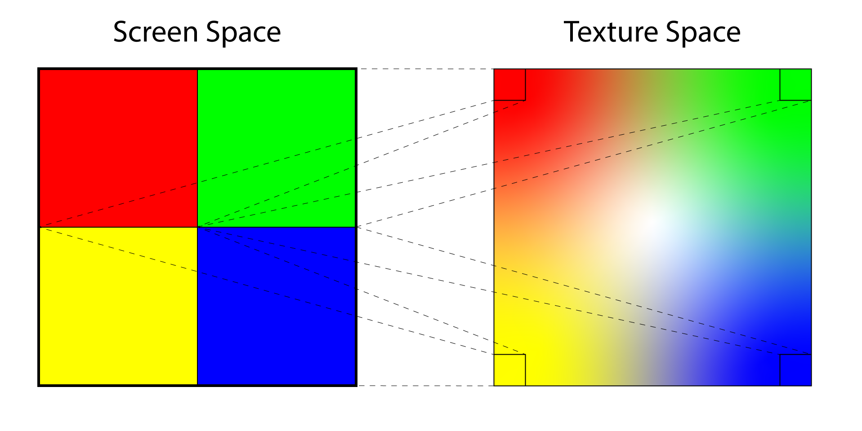
DirectX12

